Slide 1

Order Processing System
Team Members:
Shreyal Shah | Shivani Vemula | Vaishnavi Bhujbal | Shrikant Bhange
Jitendra Bisht | Anchal Chand | Anjali | Prathamesh Wavhal

Slide 2
Overview
Application Features
Application UI
Tools Used
Learning

Slide 3
Application Features
Secure login for employees and customers, allowing them to view, approve orders, and access invoices.
Securely store customer, product, and order data in a database.
Efficiently create and manage orders, with automated shipping cost calculations and status tracking.
Automatically generate daily invoices for approved orders.
Easily create pending orders (quotes) with auto-filled customer details, shipping cost calculations, and total order values.
Streamlined product data upload, validation, and updates, with clear status reporting.

Slide 4

Application UI

Slide 5
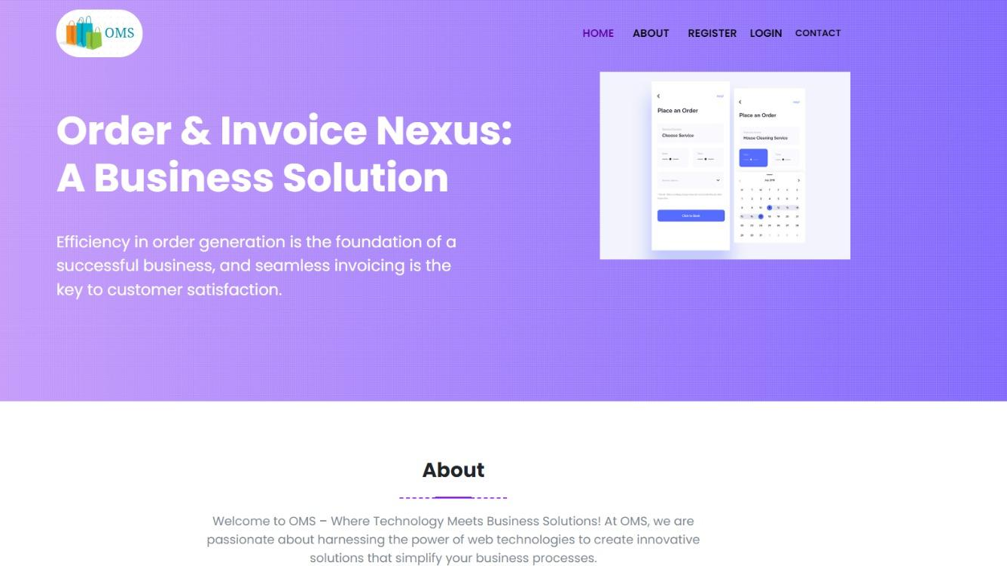
Welcome Page

Slide 6

Employee Login

Slide 7
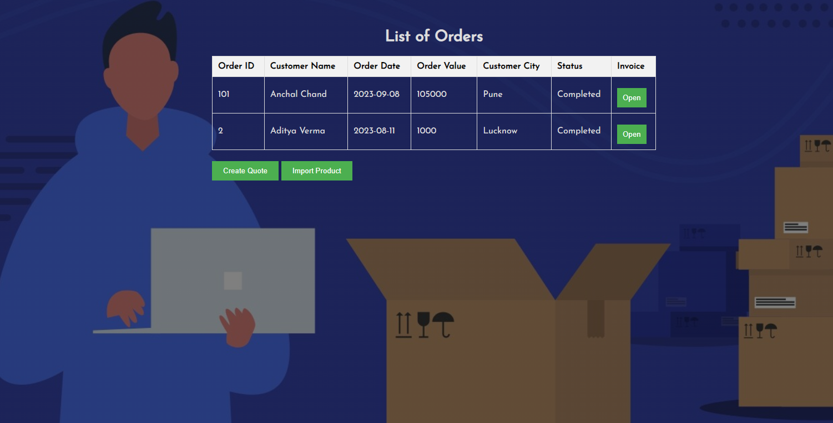
Employee Order Management

Slide 8
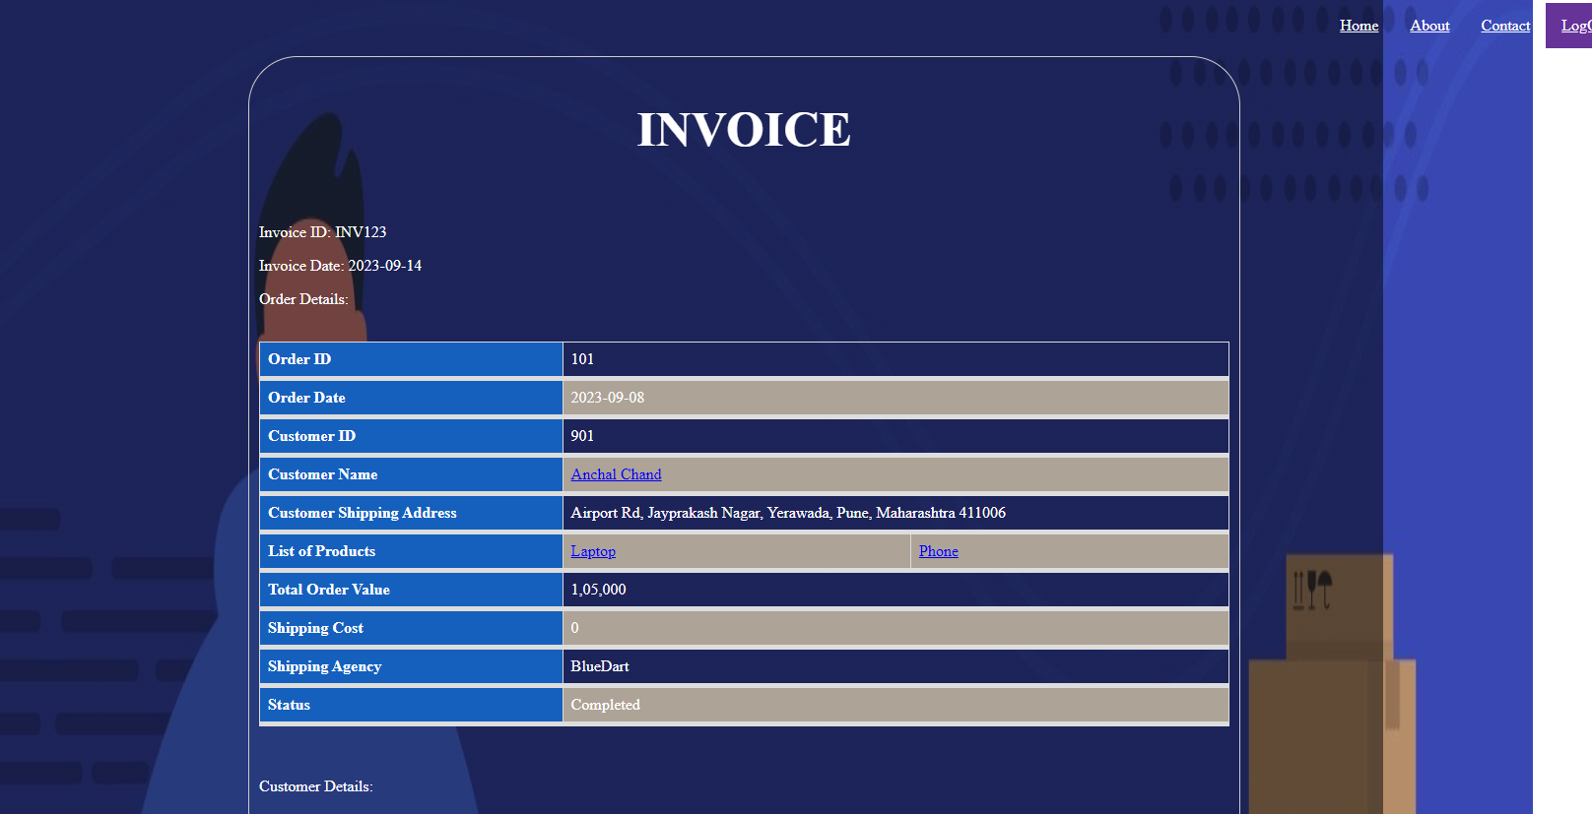
Generated Invoice

Slide 9
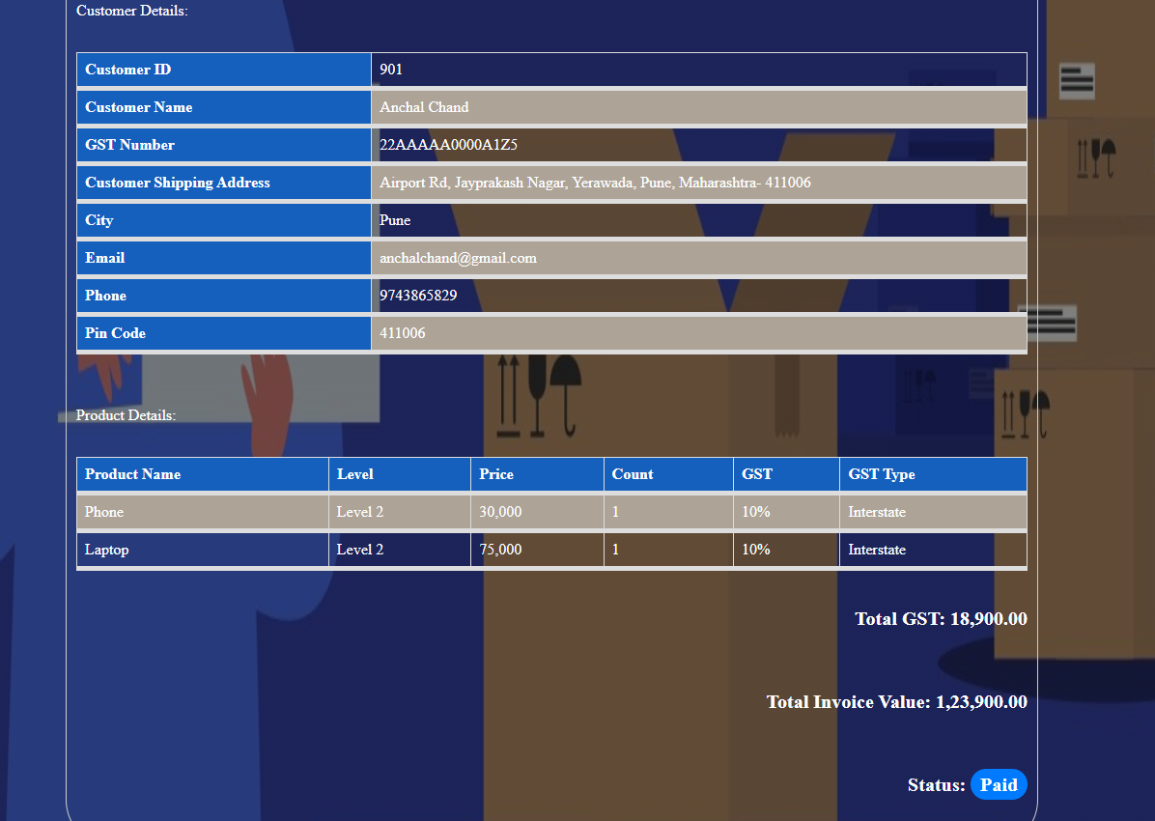
Generated Invoice

Slide 10
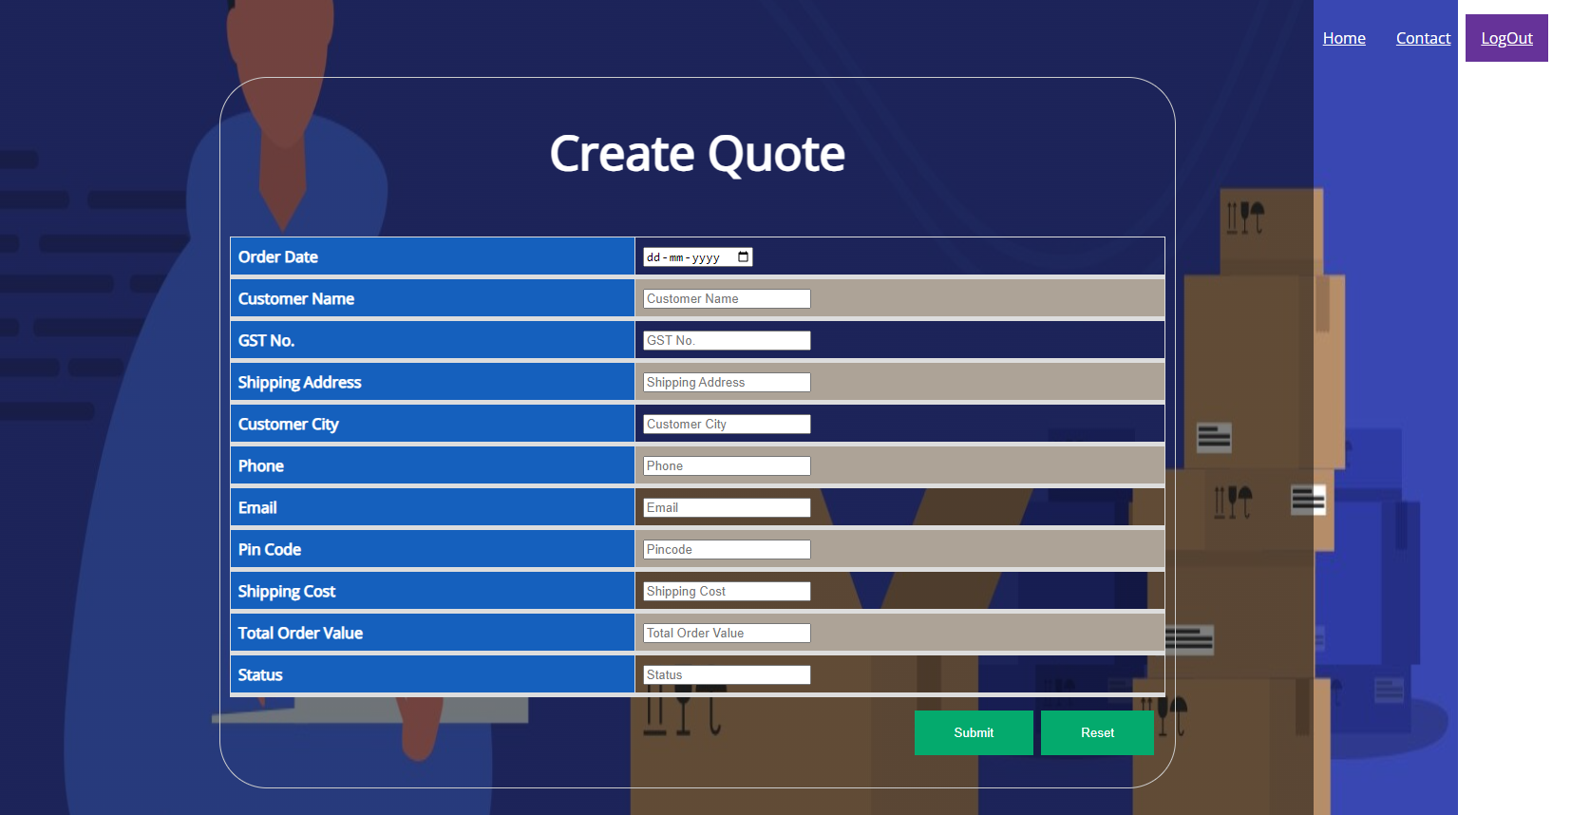
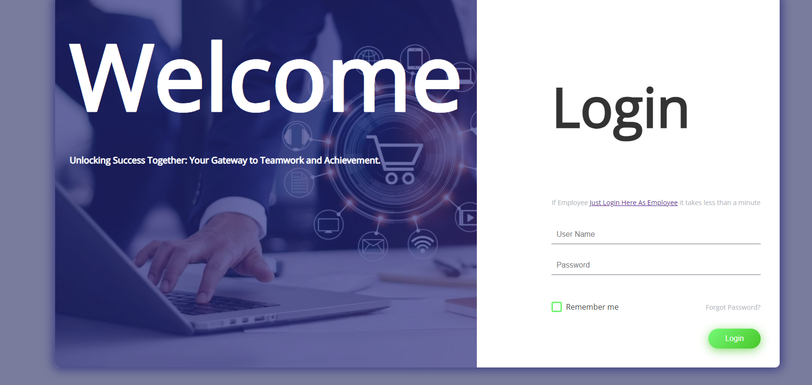
Create Quote

Slide 11
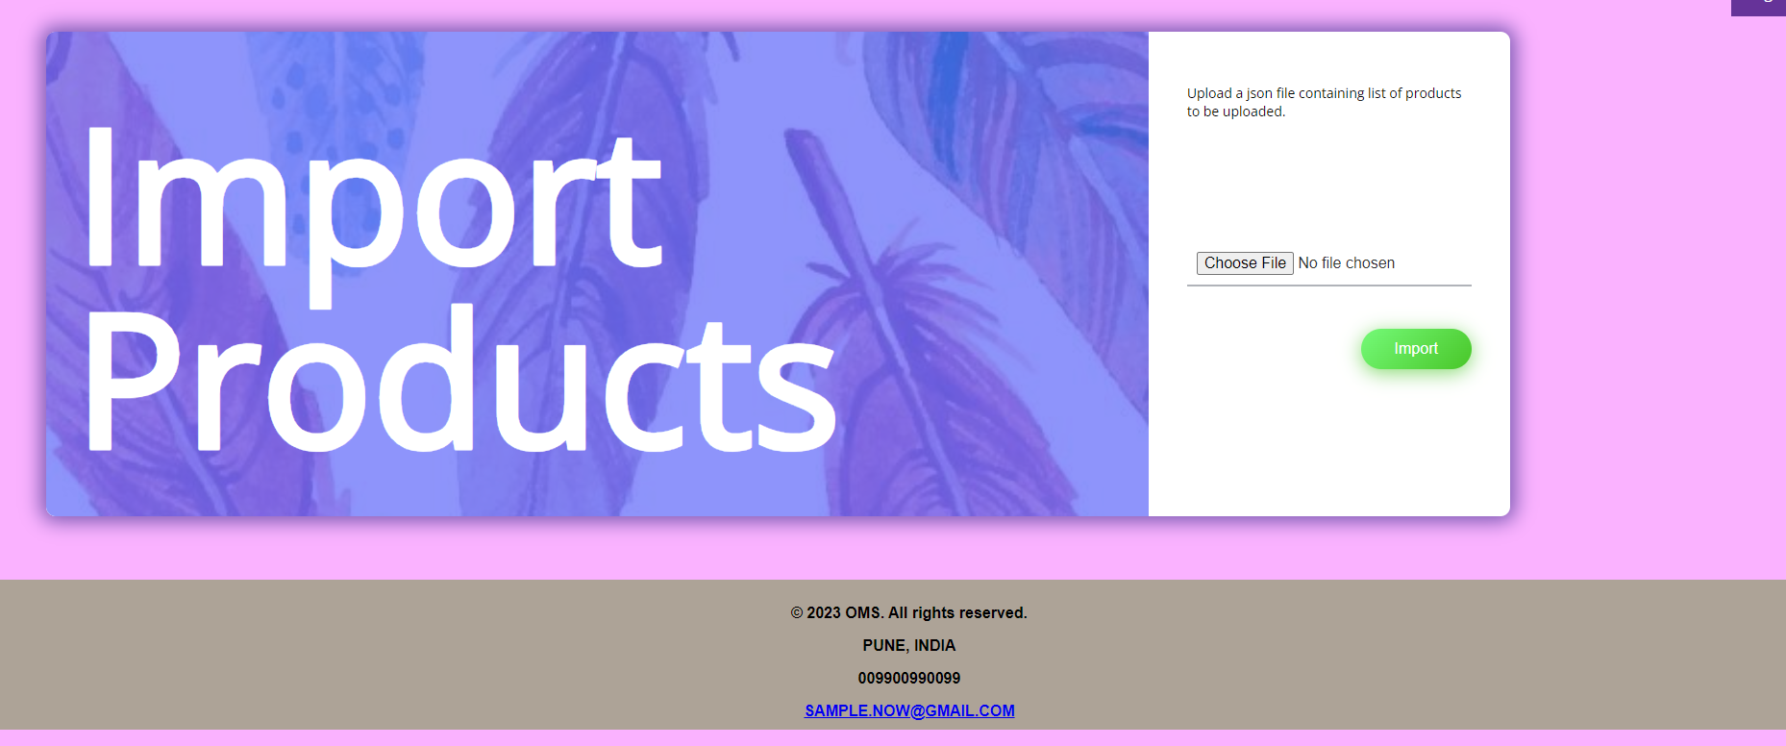
Import Products

Slide 12

Import Products

Slide 13
Customer Login

Slide 14
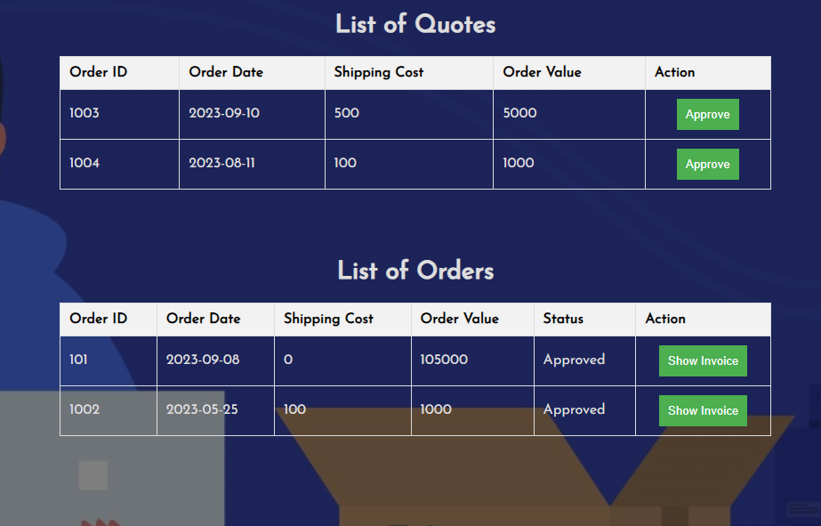
Customer Order Management

Slide 15
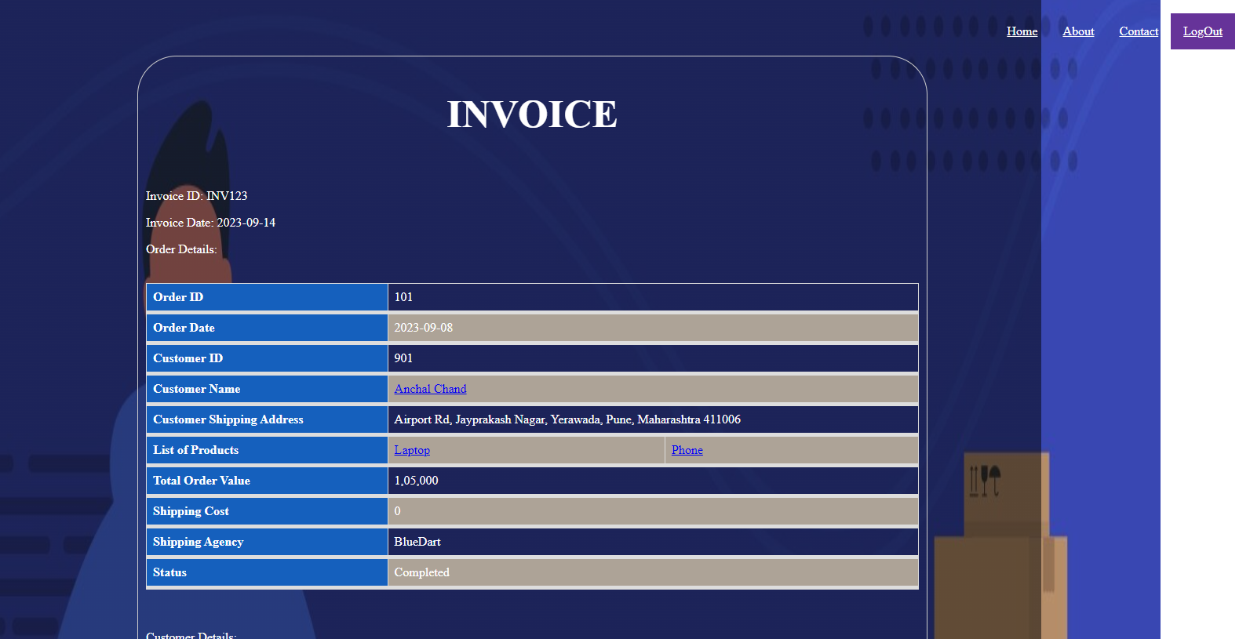
Show Generated Invoice

Slide 16
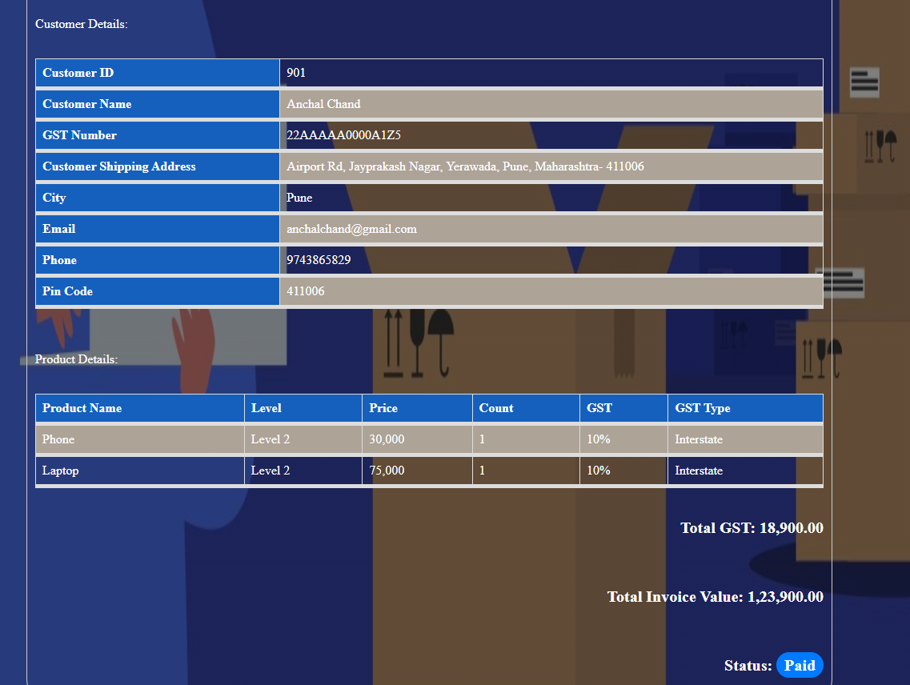
Show Generated Invoice

Slide 17
software Tools Used

Slide 18
Frontend Technologies:
HTML: Used for structuring the web pages and creating the user interface.
CSS: Applied for styling and formatting the web pages, ensuring a visually appealing design.
JavaScript: Implemented for adding interactivity, enhancing user experience, and handling client-side operations.
Backend Technologies:
Java: Utilized for server-side programming and application logic. Java provides robustness and scalability.
MySQL: Employed as the relational database management system (RDBMS) to store and manage data efficiently.

Slide 19

LeaRNINGS

Slide 20
Managing and organizing a project with multiple components and features improved our project management skills, including planning, task tracking, and prioritization.
Handling unexpected issues and changes in project requirements
Working in a team, we developed communication skills through collaboration, discussions, and reporting progress.
Adaptability
Problem-
Solving
Communication
Time
Management
Project
Management
Project presented various challenges and problems to solve, enhancing our critical thinking and troubleshooting skills.
Managing project deadline and priorities improved our time management skills

Slide 21

Thankyou

